Slide 1
Online Retail A Case Study
Kayhan Babaee
Nov 2021

Slide 2
Agenda
Goals
About Data
Planning and Assumptions
Discovery and Cleaning
Approach 1: Use description
Approach 2: Use Sales Quantity
Result and Discussions

Slide 3
Goals
How would you build a model to order supplies of a given product based on the time of year?
Write some code for data preprocessing and data exploration
Walk us through your thinking on how you approach the problem
Describe the models you would use and the pros/cons.
Using NLP techniques (if they make sense ofc) would be cool to see

Slide 4
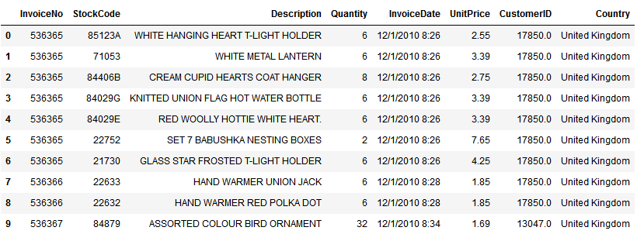
About Data
Transactional data of an online retailer with one year duration (2010-2011) and half of million entries
Fields:
InvoiceNo
StockCode
Description
Quantity
InvoiceDate
UnitPrice
CustomerID
Country

Slide 5
Planning and Assumptions
Based on the data fields and goals:
Clustering can useful compare to product level prediction because of the possible noise and complexity.
We can use product descriptions to group products and study the behavior of the groups. Therefore when we have a new product description, we can guess how much it can sell.
Pros: This can be useful as we are not bound to a specific id product.
Cons: there’s a chance that this hypothesis is wrong.
We can use product sales directly and group products based on that.
Pros: chance of grouping is much higher
Cons: we are bound to a specific id product.
Hybrid:
Pros: probably much higher accuracy than both
Cons: hard to implement and tune

Slide 6
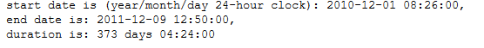
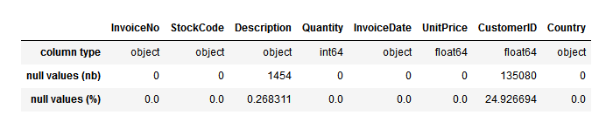
Discovery and cleaning
25% null for customer ids which can be caused by the guest customer. less than 0.5% null values for descriptions. changing null customers to id= -1 and null description to empty cell.
Convert invoice date to datetime format.

Slide 7
Discovery and cleaning
For InvoiceNo, StockCode, Description, Country:
Remove all trailing and leading spaces
Make sure they are lower case
U.K by far and Germany and France are the prominent countries in order-level data.

Slide 8
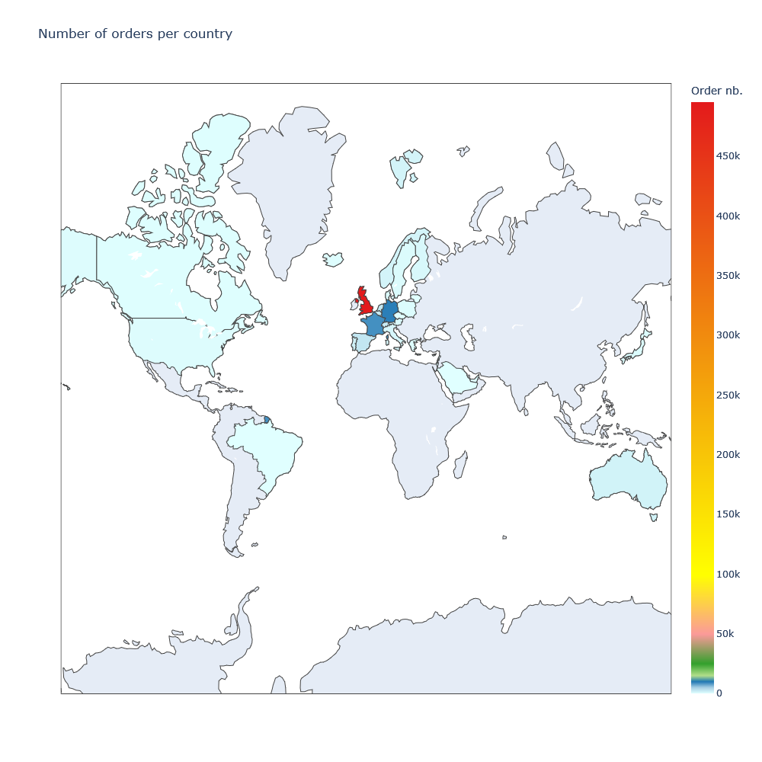

Slide 9
Discovery and cleaning
Checking unique values in each columns:
InvoiceNo unique count and percentage: 25900, 4.78
StockCode unique count and percentage: 3958, 0.73
Description unique count and percentage: 4195, 0.77
Quantity unique count and percentage: 722, 0.13
InvoiceDate unique count and percentage: 23260, 4.29
UnitPrice unique count and percentage: 1630, 0.30
CustomerID unique count and percentage: 4373, 0.81
Country unique count and percentage: 38, 0.01
As it was mentioned before data seems to be very spotty (looking at InvoiceDate).

Slide 10
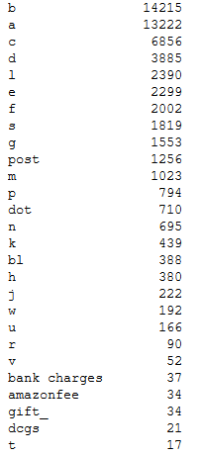
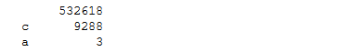
Discovery and cleaning
Character and numbers are separated for these two columns:
InvoiceNo and StockCode
This can help us to find the cancelled orders (with c in InvoiceNo) and find the root products (not variant) of each sales.
Extracted
characters

Slide 11
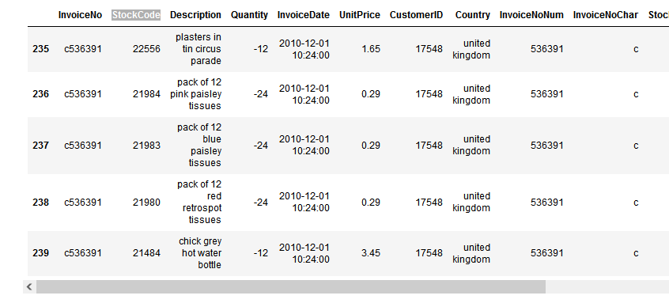
Discovery and cleaning
cancelled orders seems to not carry useful information and there’s no counter part (main order based on invoice id) in data. They will be removed.

Slide 12
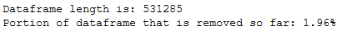
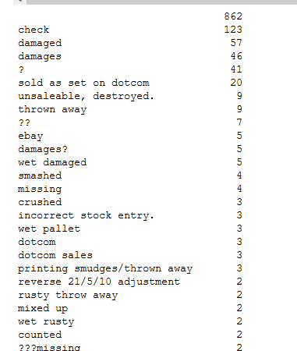
Discovery and cleaning
Orders with minus quantity are not useful too.

Slide 13
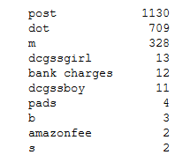
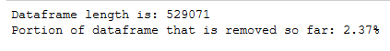
Discovery and cleaning
Orders that StockCode can’t be extracted as digits will be removed.

Slide 14
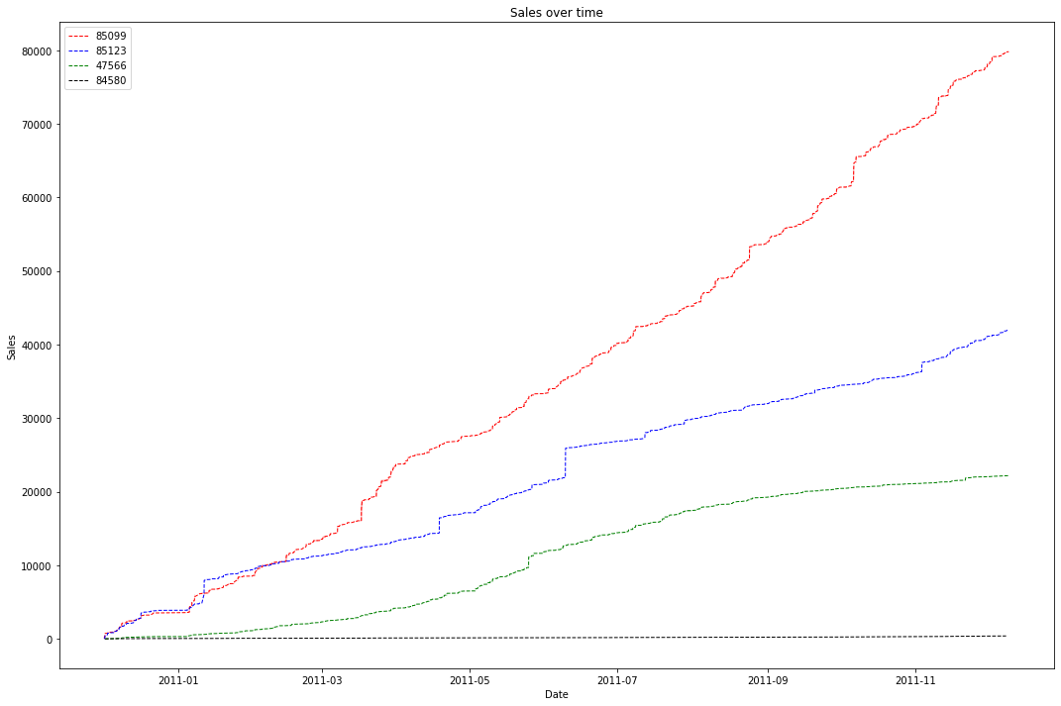
Cumulative sum of the most frequent

Slide 15
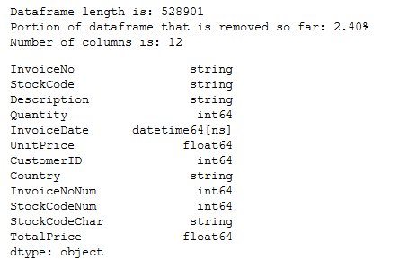
Discovery and cleaning
Try to replace products with zero unit price with average of stock code products.
Try to assign description to products without description using stock code.
Clean data saved in the data directory.

Slide 16
Approach 1: Use description
First we need to make sure the description column goes through preprocessing to remove unnecessary information (stop words, numbers, etc.) and normalize and lemmatize.
Then a feature vector can be extracted from each description and grouping can happen afterward.
K-means and Fast Community detection are the candidates:
K-means:
Pros: If number of clusters is calculated correctly will be the most accurate.
Cons: For large dataset, can be very slow.
Fast Community detection:
Pros: Finding Centers of cluster will be fast can be used as the model for the inference.
Cons: Overlapping cluster needs to be take care of.

Slide 17
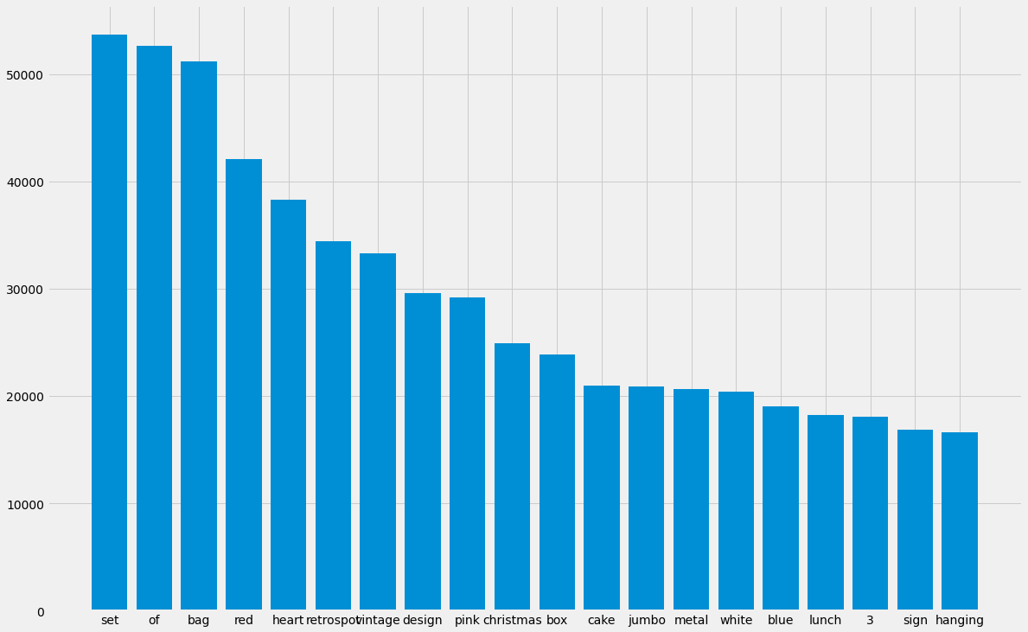
Most Frequent Words before

Slide 18
Regular Expression Processes
Case folding: ßßß > ssssss
Removing number digits: 191
Removing possessive: ‘s
Removing special characters: !#$%
Removing short words: 2charcters: if in
Remove extra whitespace and tabs:
Removing colors and stop words: gray, the
Lemmatization

Slide 19
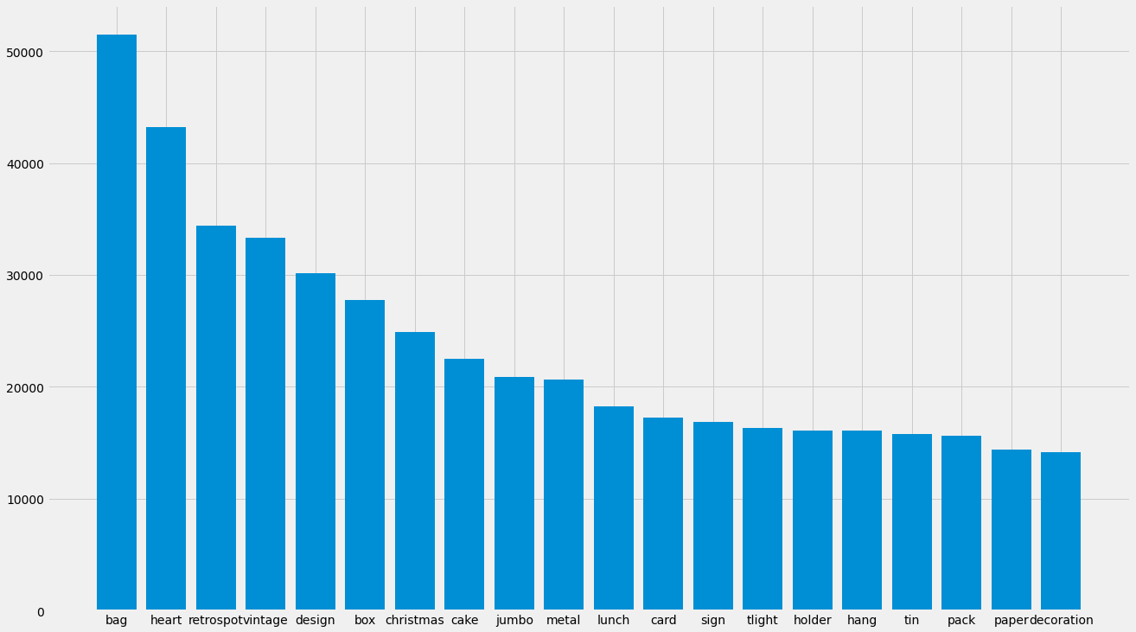
Most Frequent Words after

Slide 20
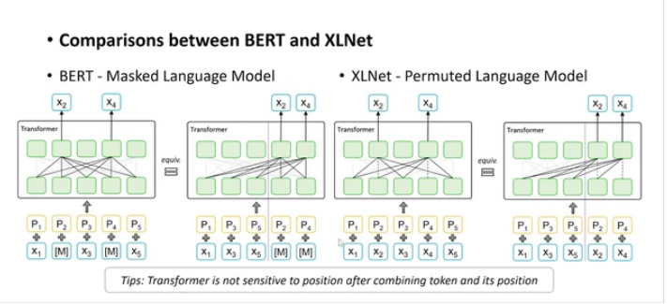
Tokenization and Feature extraction
From sentence-embedding liberty and using hugging-face, we used MPNet: Masked and Permuted Pre-training for Language Understanding pretrained model which tokenize each description and use mean pooling to find the representation for each description.
This is a general purpose model and return dimension of the tensor is 1x768 and max length of sequence is 75.

Slide 21
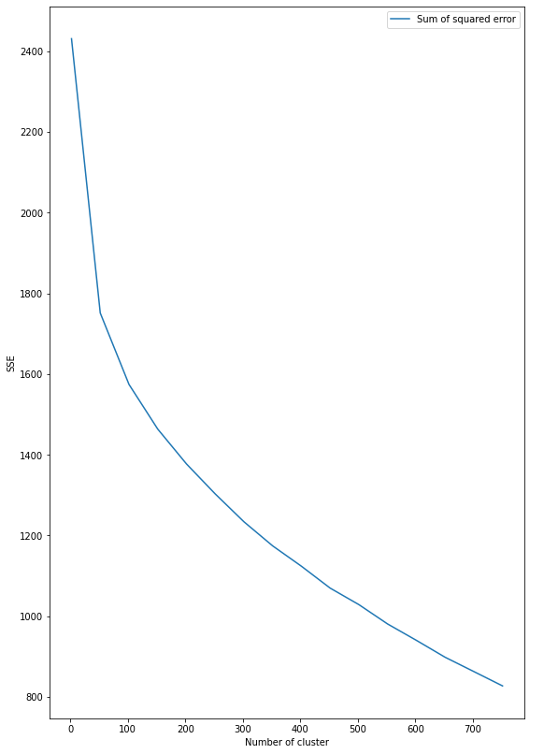
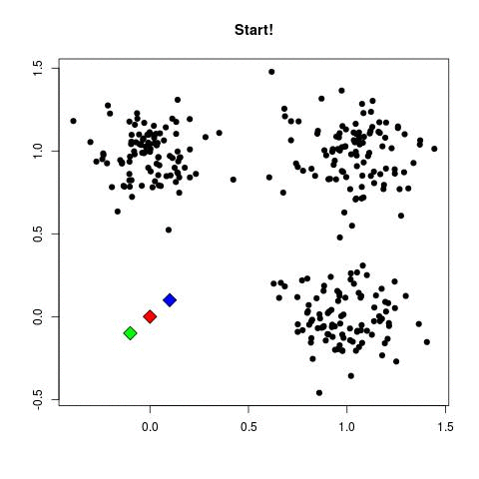
K-means

Slide 22
Sample of K-means Clusters
Cluster 1
['glass tassle bag charm', 'fruit salad bag charm', 'summer daisy bag charm', 'summer butterfly bag charm', 'amber glass tassle bag charm', 'bertie glass bead bag charm', 'daisy bag charm', 'metalic leave bag charm', 'metal bag charm', 'copper brass bag charm']
Cluster 51
['ribbon reel make snowman', 'ribbon reel snowy village', 'ribbon reel christmas present', 'ribbon reel sock mitten', 'ribbon reel stripe design', 'ribbon reel polkadot', 'ribbon reel flora fauna', 'ribbon reel lace design', 'vintage tinsel reel', 'ribbon reel heart design', 'embroidered ribbon reel emily', 'embroider ribbon reel ruby', 'embroidered ribbon reel rebecca', 'embroidered ribbon reel daisy', 'embroidered ribbon reel sally', 'embroidered ribbon reel rachel', 'embroidered ribbon reel rosie', 'embroidered ribbon reel susie', 'embroidered ribbon reel sophie', 'embroidered ribbon reel claire']
Cluster 101
['retrospot oven glove', 'tec alpine hand warm', 'retrospot oven glove double', 'tea time oven glove', 'rise sud oven glove', 'gingham oven glove heart', 'teatime push rubber']

Slide 23
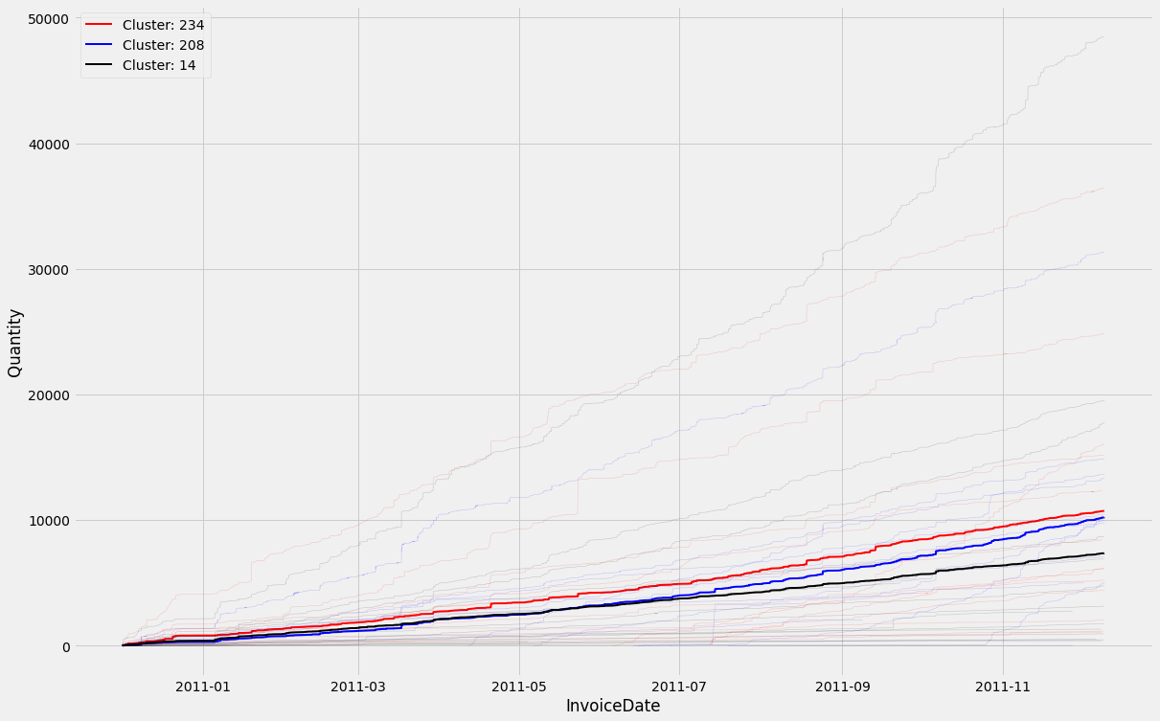
K-means Quantity Cumulative Sum

Slide 24
Approach 2: Use Sales Quantity

Slide 25
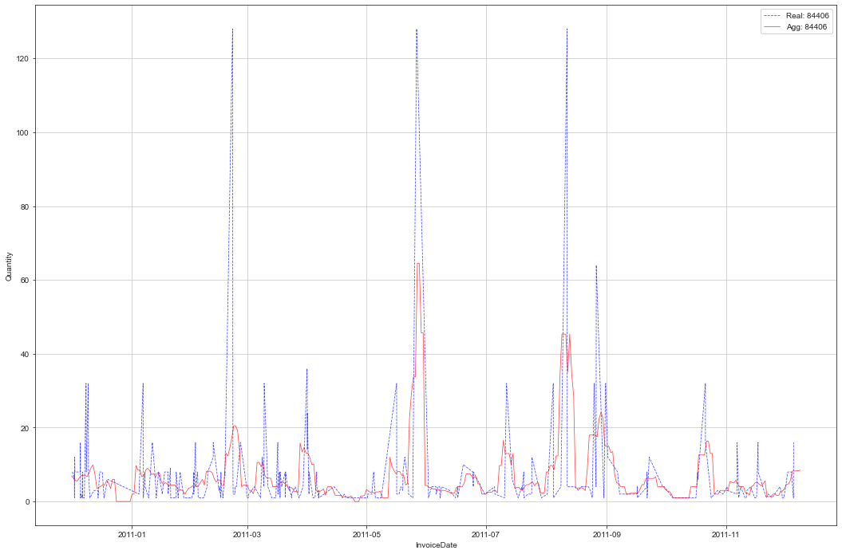
Moving average and Merging Time Series

Slide 26
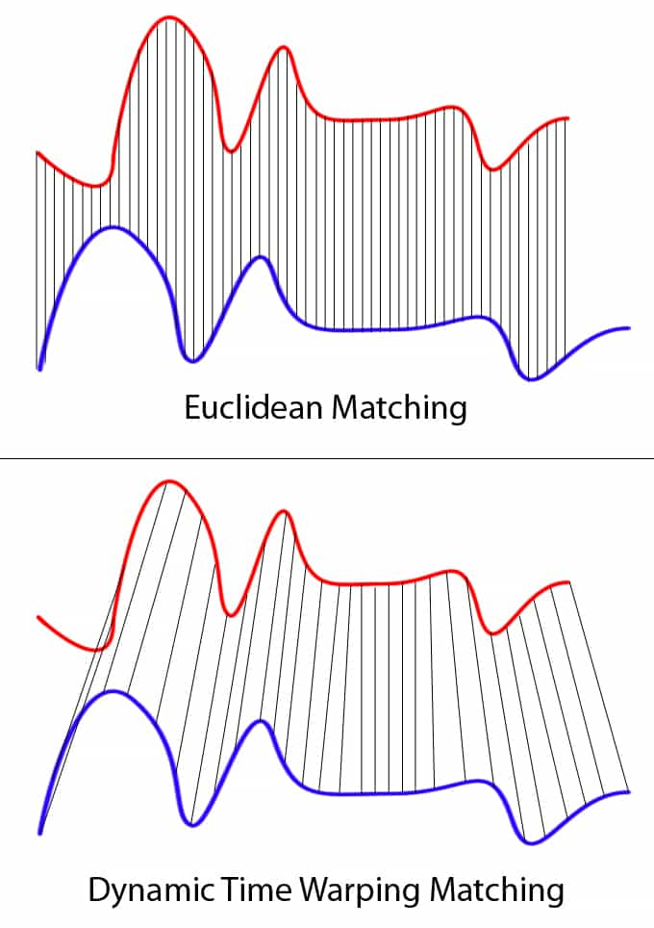

Slide 27
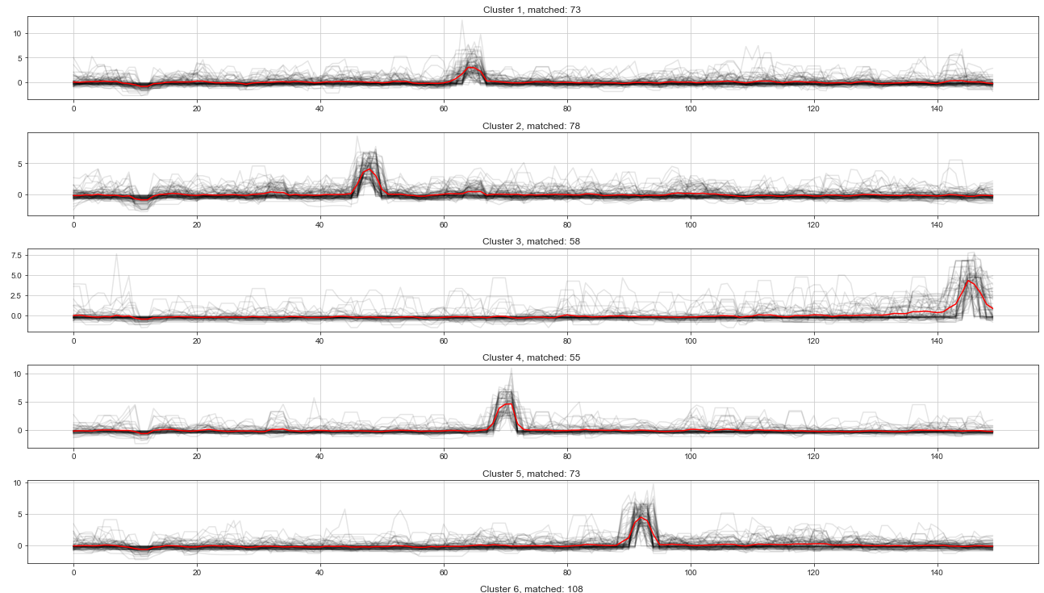
Euclidian Metric

Slide 28
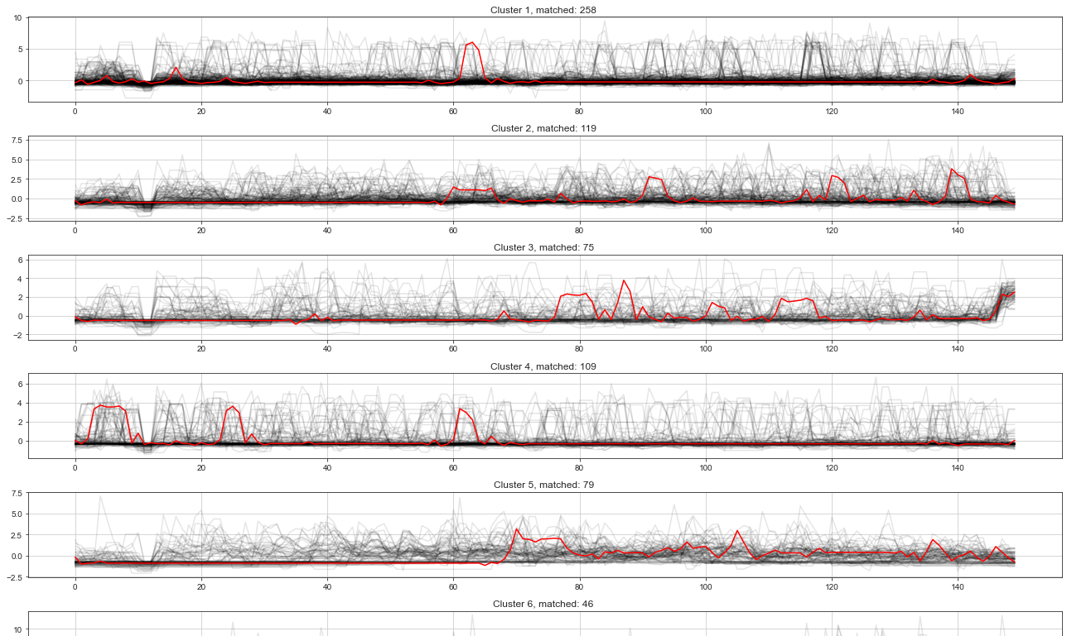
Dynamic time warping

Slide 29
Result and discussions
Planned Goals:
Achieved Goals:
Suggestions:
Code: https://github.com/KayhanB21/online-retail

Slide 30
Question(s)??

